Slide 1
Introduction – Cyber Security
Dr. Arshad Farhad

Slide 2
Aspects of Security
consider 3 aspects of information security:
security attacks
security services
security mechanisms
Notes:
The OSI security architecture focuses on security attacks,mechanisms,and services. These can be defined briefly as follows:
• Security attack: Any action that compromises the security of information owned by an organization.
• Security mechanism: A process (or a device incorporating such a process) that is designed to detect, prevent,or recover from a security attack.
• Security service: A processing or communication service that enhances the security of the data processing systems and the information transfers of an organization. The services are intended to counter security attacks, and they make use of one or more security mechanisms to provide the service.

Slide 3
Security Attack
any action that compromises the security of information owned by an organization
often threat & attack used to mean same thing
Threat: A person, thing, event, or idea which poses some danger to an asset in terms of that asset's confidentiality, integrity, availability.
Attack: A realization of a threat; Any action that attempts to compromise the security of the information owned by an organization/person

Slide 4
Attacks
Nature of attacks
Active attacks
Passive attacks
Categorization of attacks
Interruption
Interception
Modification
Fabrication

Slide 5
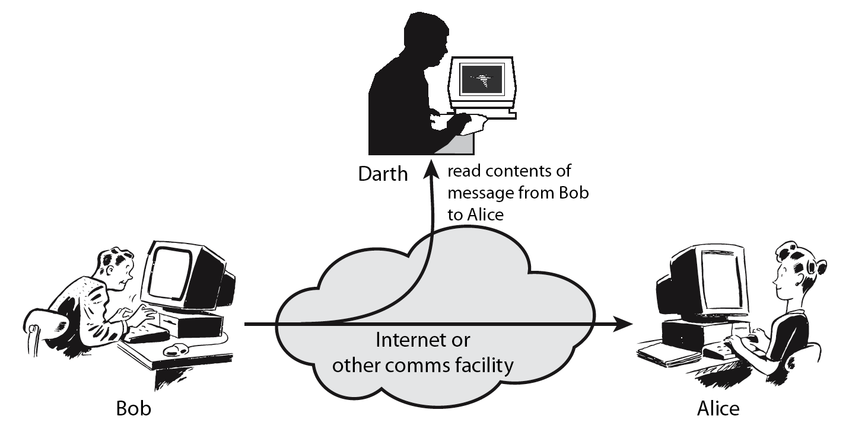
Passive Attacks
Notes:
Have “passive attacks” which attempt to learn or make use of information from the system but does not affect system resources.
By eavesdropping on, or monitoring of, transmissions to:
+ obtain message contents or
+ monitor traffic flows
Are difficult to detect because they do not involve any alteration of the data.

Slide 6
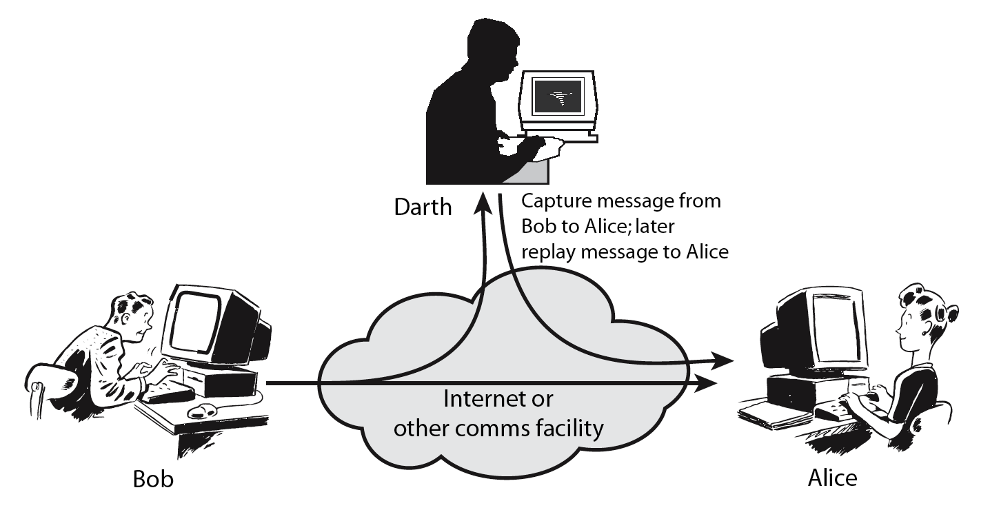
Active Attacks
Notes:
Also have “active attacks” which attempt to alter system resources or affect their operation.
By modification of data stream to:
+ masquerade of one entity as some other
+ replay previous messages
+ modify messages in transit
+ denial of service
Active attacks present the opposite characteristics of passive attacks. Whereas passive attacks are difficult to detect, measures are available to prevent their success. On the other hand, it is quite difficult to prevent active attacks absolutely, because of the wide variety of potential physical,software,and network vulnerabilities. Instead, the goal is to detect active attacks and to recover from any disruption or delays caused by them.

Slide 8
Security Service
enhance security of data processing systems and information transfers of an organization
intended to counter security attacks
using one or more security mechanisms
Notes:
Consider the role of a security service, and what may be required.
Note both similarities and differences with traditional paper documents, which for example:
have signatures & dates;
need protection from disclosure, tampering, or destruction;
may be notarized or witnessed;
may be recorded or licensed

Slide 9
Security Services (X.800)
Authentication - assurance that the communicating entity is the one claimed
Access Control - prevention of the unauthorized use of a resource
Data Confidentiality –protection of data from unauthorized disclosure
Data Integrity - assurance that data received is as sent by an authorized entity
Non-Repudiation - protection against denial by one of the parties in a communication

Slide 10
Security Mechanisms
feature designed to detect, prevent, or recover from a security attack
no single mechanism that will support all services required
however one particular element underlies many of the security mechanisms in use:
cryptographic techniques
hence our focus on this topic
Notes:
Now introduce “Security Mechanism” which are the specific means of implementing one or more security services.
Note these mechanisms span a wide range of technical components, but one aspect seen in many is the use of cryptographic techniques.

Slide 11
Data Privacy in communication … Services & Mechanisms
Confidentiality: Unauthorized parties cannot access information (->Secret Key Encryption)
Authenticity: Ensuring that the actual sender is the claimed sender. (->Public Key Encryption)
Integrity: Ensuring that the message was not modified in transmission. (->Hashing)
Nonrepudiation: Ensuring that sender cannot deny sending a message at a later time. (->Digital Signature)
Bill
Confidentiality
Joe
Bill
Authenticity
Joe (Actually Bill)
Ann
Ann
Integrity
Joe
Non-Repudiation
Joe
Bill
Ann
Ann
Notes:
The tools in parenthesis provide the features specified.

Slide 12
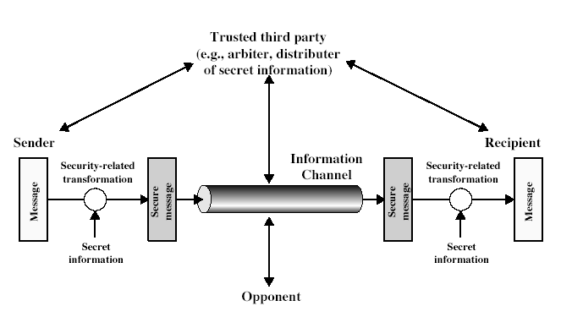
Model for Security

Slide 13
Model for Security
using this model requires us to:
design a suitable algorithm for the security transformation
generate the secret information (keys) used by the algorithm
develop methods to distribute and share the secret information

Slide 14
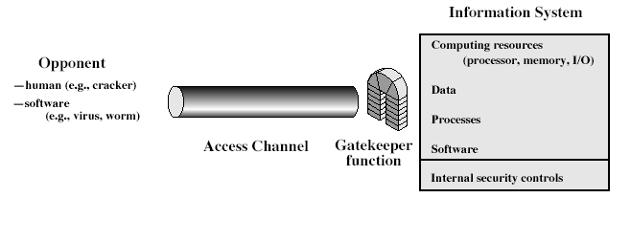
Model for Network Access Security

Slide 15
Model for Network Access Security
using this model requires us to:
select appropriate gatekeeper functions to identify users
implement security controls to ensure only authorised users access designated information or resources

Slide 16
Statistics
According the certain estimates by McAfee & Kapersky Lab, the cost of information security breaches that took place in 2018 was worth $600 billion.
Globally, information security breaches have witnessed a steep increase of 67% in the last five years
In last quarter of 2018, a single incident of cyberattack on Private Bank operating in Pakistan resulted in the loss of $6 million in just 23 minutes

Slide 17
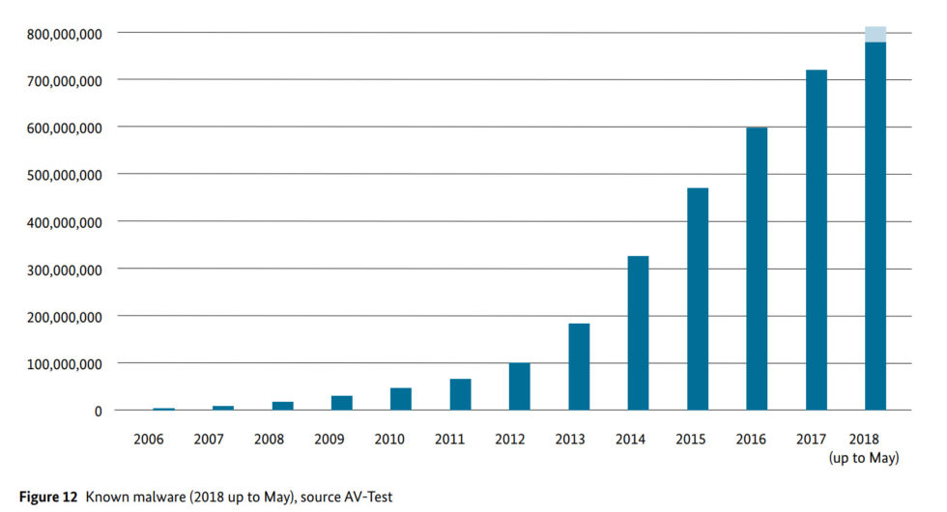
Malware Count

Slide 18
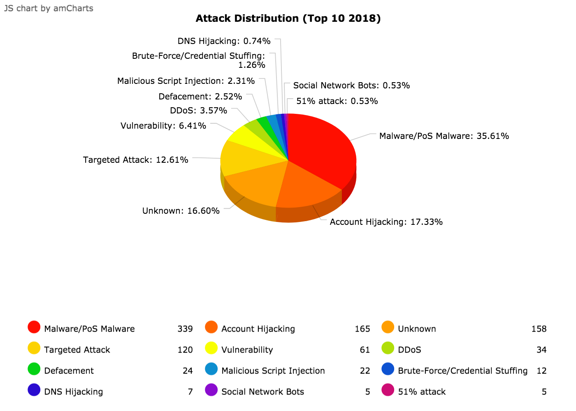
https://www.hackmageddon.com/

Slide 19
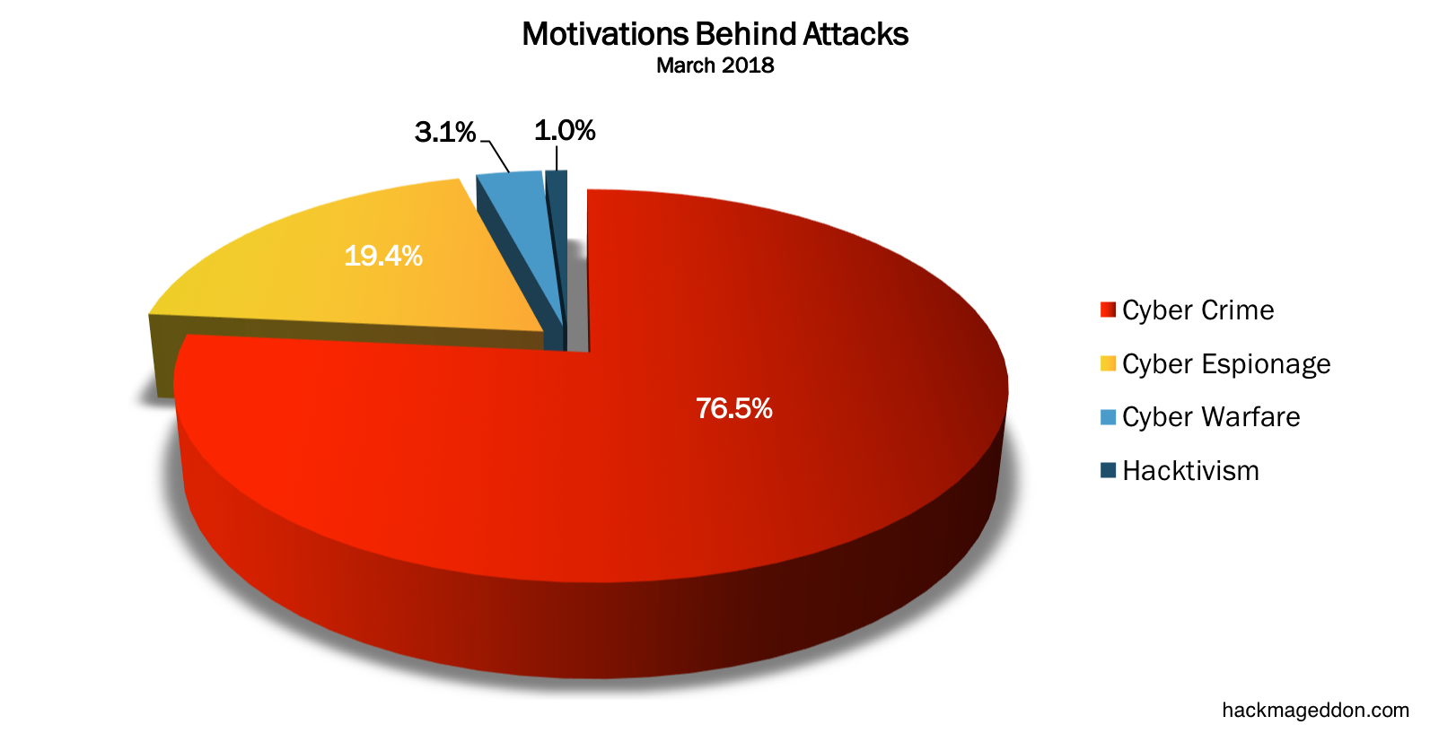
https://www.hackmageddon.com/

Slide 20
Why do we need security?
Lets go through some real-world examples.

Slide 21
Mirai Botnet – Case Study
First identified in August 2016 by the whitehat security research group MalwareMustDie, Mirai—Japanese for “the future”—and its many variants have served as the vehicle for some of the most potent DDoS attacks in history.
In September 2016, the website of computer security consultant Brian Krebs was hit with 620 gbps of traffic, “many orders of magnitude more traffic than is typically needed to knock most sites offline.”2 At about the same time, an even bigger DDoS attack using Mirai malware—peaking at 1.1 Tbps— targeted the French webhost and cloud service provider OVH
https://www.rsaconference.com/writable/presentations/file_upload/hta-w10-mirai-and-iot-botnet-analysis.pdf
https://www.imperva.com/blog/malware-analysis-mirai-ddos-botnet/?utm_campaign=Incapsula-moved
https://www.csoonline.com/article/3258748/the-mirai-botnet-explained-how-teen-scammers-and-cctv-cameras-almost-brought-down-the-internet.html

Slide 22
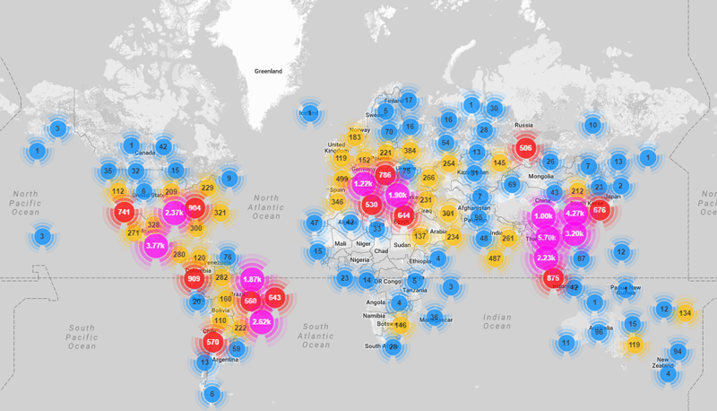
Mirai - Bots
https://www.imperva.com/blog/malware-analysis-mirai-ddos-botnet/?utm_campaign=Incapsula-moved

Slide 23
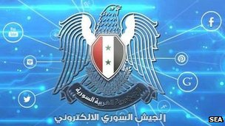
New York Times and Twitter struggle after Syrian hack … (2013)
The newspaper and social network were hit after their domain name details were maliciously edited by hackers.
The Syrian Electronic Army (SEA), a group supporting Syrian president Bashar al-Assad, says it carried out the attack.
In recent months, these hackers have targeted major media companies including the Financial Times, Washington Post, CNN and BBC.
The SEA was able to gain access to Melbourne IT's system, where Twitter and the New York Times registered their respective domains.
http://www.bbc.co.uk/news/technology-23862105

Slide 24
Major banks hit with biggest cyber attacks in history… (2012)
The websites of Bank of America, JPMorgan, U.S. Bank and PNC Bank all suffered day-long slowdowns and been sporadically unreachable for many customers ….
A denial of service attack
The attackers got hold of thousands of high-powered application servers and pointed them all at the targeted banks.
The volume of traffic sent to these sites was 10 to 20 times the volume that was normally recorded.
http://money.cnn.com/2012/09/27/technology/bank-cyberattacks/index.html
By David Goldman CNN September 28, 2012

Slide 25
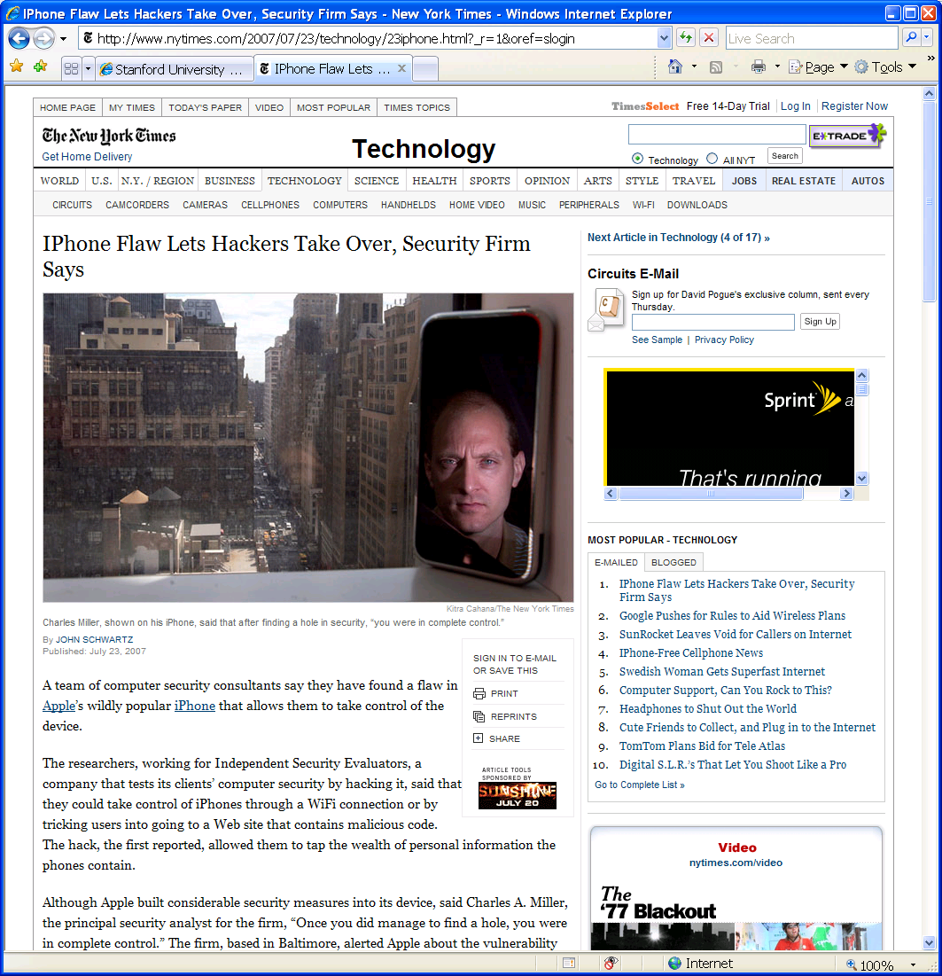
iPhone attack … (2007)
iPhone Safari downloads malicious web page
Arbitrary code is run with administrative privileges
Can read SMS log, address book, call history, other data
could dial phone numbers, send text messages, or record audio
Transmit collected data over network to attacker
http://www.securityevaluators.com/iphone/

Slide 26
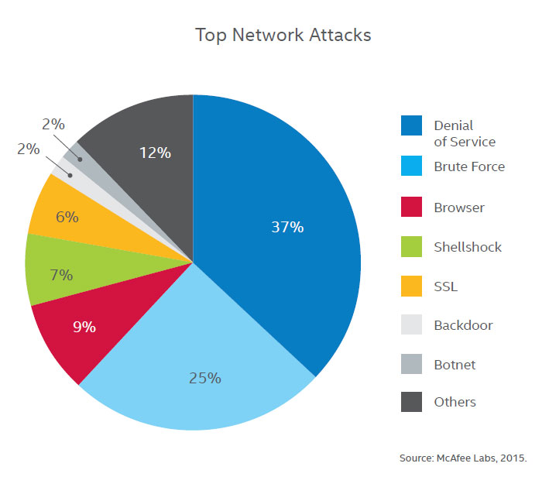
Top 7 Network Attacks of 2015 … so far June 2015
http://www.calyptix.com/top-threats/top-7-network-attack-types-in-2015-so-far/

Slide 27
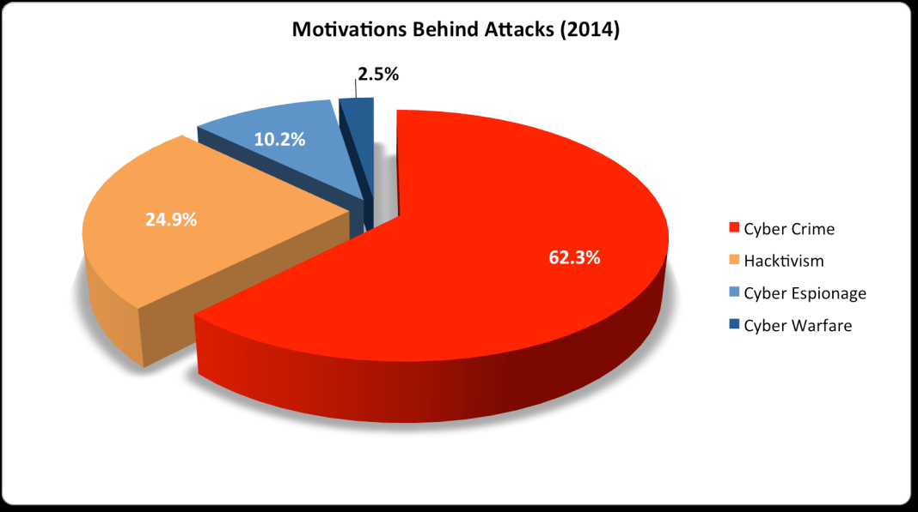

Slide 28
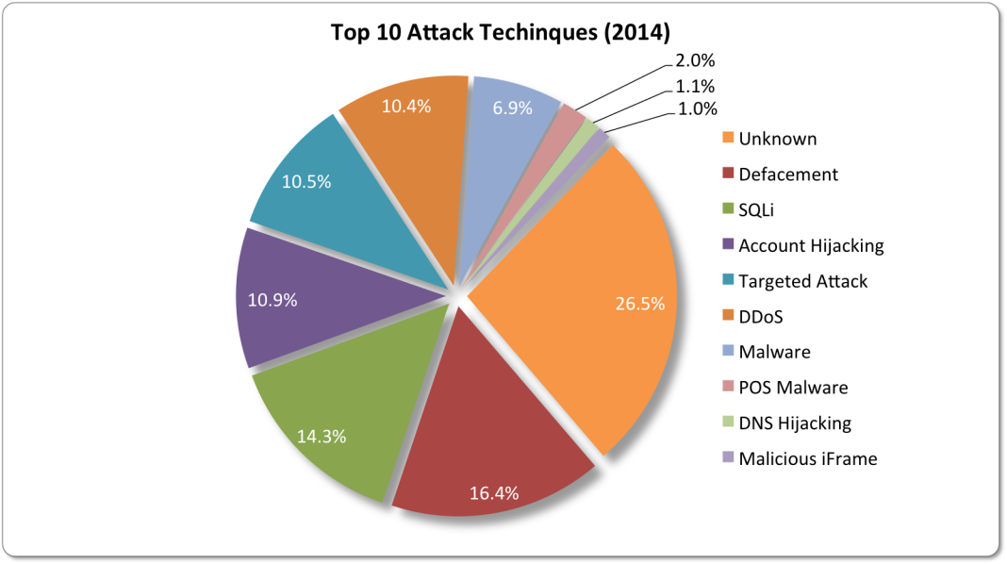
Top 10 network attacks techniques of 2014
Notes:
Website defacement is an attack on a website that changes the visual appearance of the site or a webpage. These are typically the work of system crackers, who break into a web server and replace the hosted website with one of their own.
Point-of-sale malware (POS malware) is malicious software expressly written to steal customer payment data -- especially credit card data -- from retail checkout

Slide 29
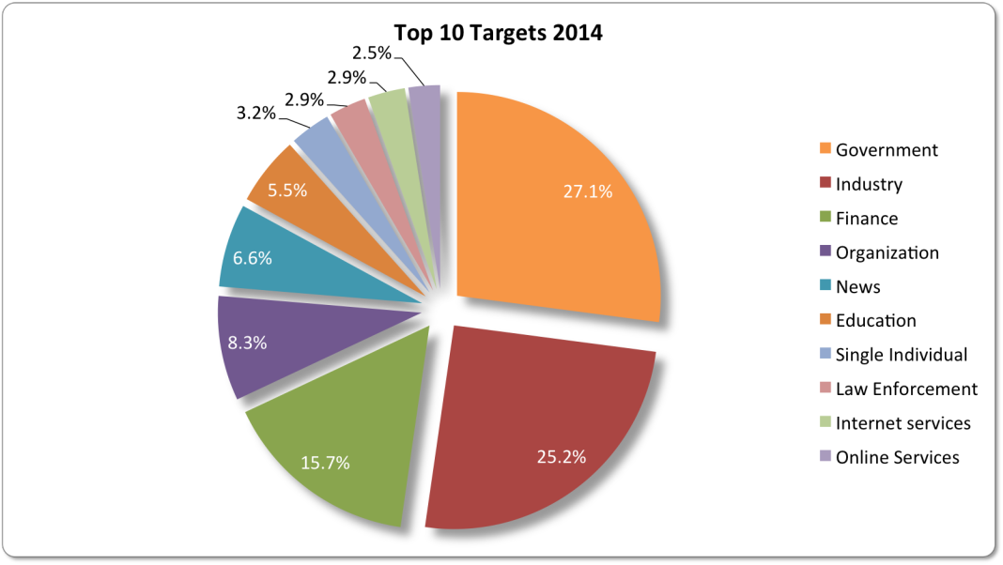

Slide 30
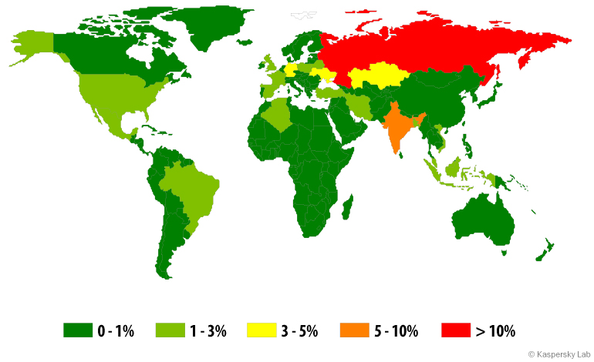
Mobile threats 2014

Slide 31
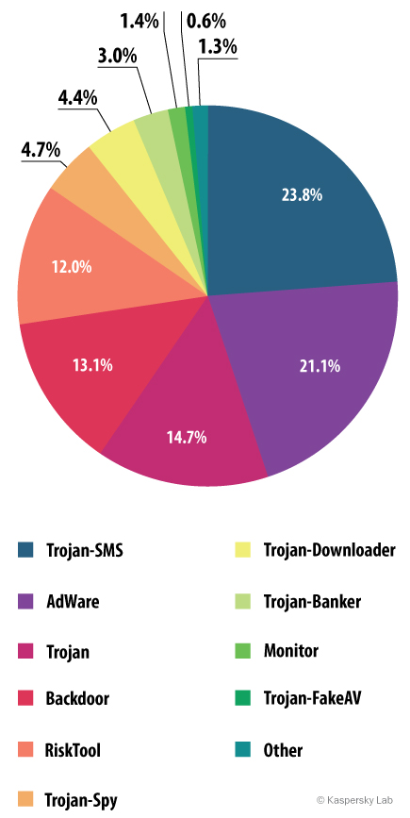
Mobile threats 2014

Slide 32
Top 5 out of 20 Mobile threats of 2014
1 | Trojan-SMS.AndroidOS.Stealer.a | 18.0%
2 | RiskTool.AndroidOS.MimobSMS.a | 7.1%
3 | DangerousObject.Multi.Generic | 6.9%
4 | RiskTool.AndroidOS.SMSreg.gc | 6.7%
5 | Trojan-SMS.AndroidOS.OpFake.bo | 6.4%

Slide 33
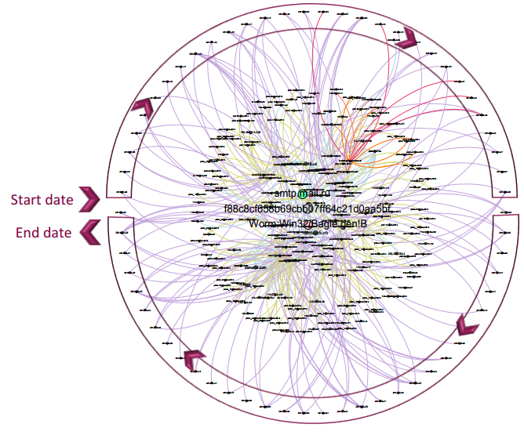
Mass-scale Organizational Targeted Attacks (MOTAs)
Bagle mass-mailer worm campaign between January 1, 2014, and April 29, 2014
Source: Symantec April 2015
Notes:
targeted no less than 12 companies located in Europe, Asia, and Australia; and was active in seven different industry sectors, including public administration, finance
and insurance, and transportation. A total of 155 emails were sent over a period of about four months. This campaign thus appears loosely focused.
When looking at the file attached to the emails, we can see that all emails were carrying a variant of the Bagle worm (Worm:Win32/Bagle.gen!B), which is a piece of code that replicates itself automatically by sending copies of itself via an attached file in an email.
Although the attached file name (pattern: “[8-12 characters].exe”) was different in almost every spear phishing email, the content of the file was identical throughout the campaign (md5=f88c8cf658b69cbb07ff64c-21d0aa5bf). Moreover, the subject line included in the emails varied with the attachment file name and always followed the pattern “price[ -_][date in the format dd-mm-yyyy].” Also, we found that the instance of the Bagle worm observed in this campaign used the free Russian mail
service mail.ru to send the emails through which it replicated itself.
Symantec customers were protected against these attacks.

Slide 34
Recent Trends
Malware, worms, and Trojan horses
spread by email, instant messaging, malicious or infected websites
Botnets and zombies
improving their encryption capabilities, more difficult to detect
Scareware – fake/rogue security software
Attacks on client-side software
browsers, media players, PDF readers, etc.
Ransom attacks
malware encrypts hard drives, or DDOS attack
Social network attacks
Users’ trust in online friends makes these networks a prime target.
Texas CISO, Feb 2010

Slide 35
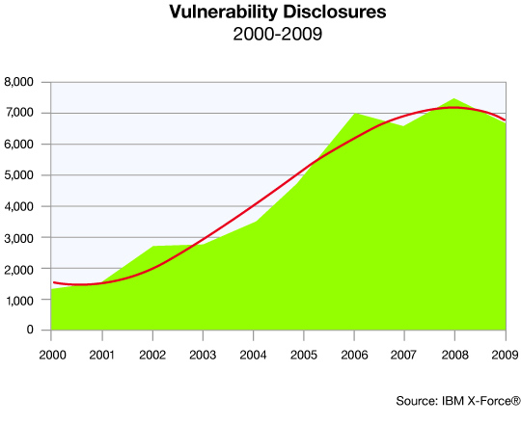
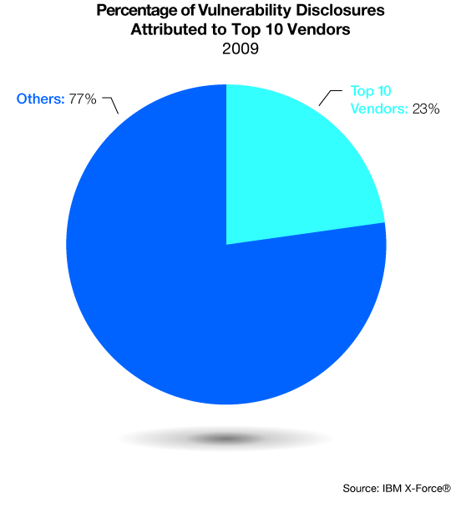
Trends

Slide 36
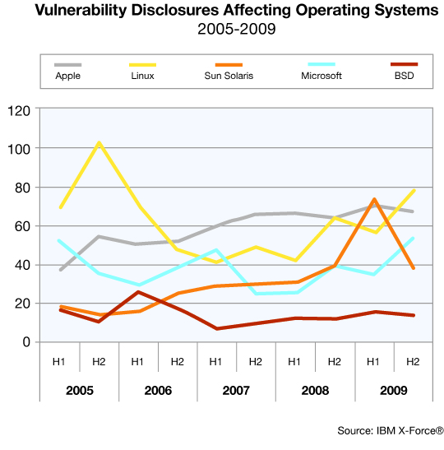
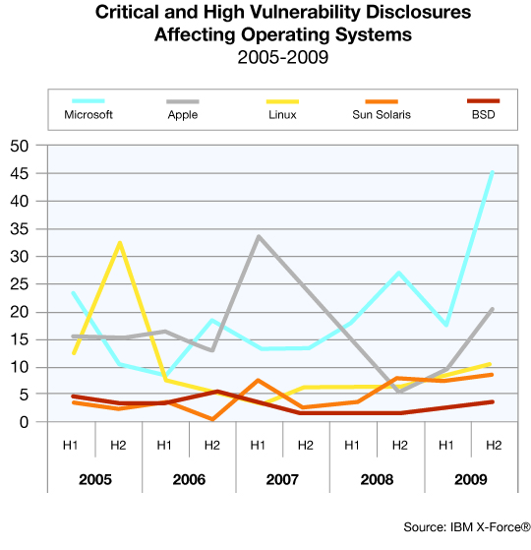
Operating system vulnerabilities

